Slide 1
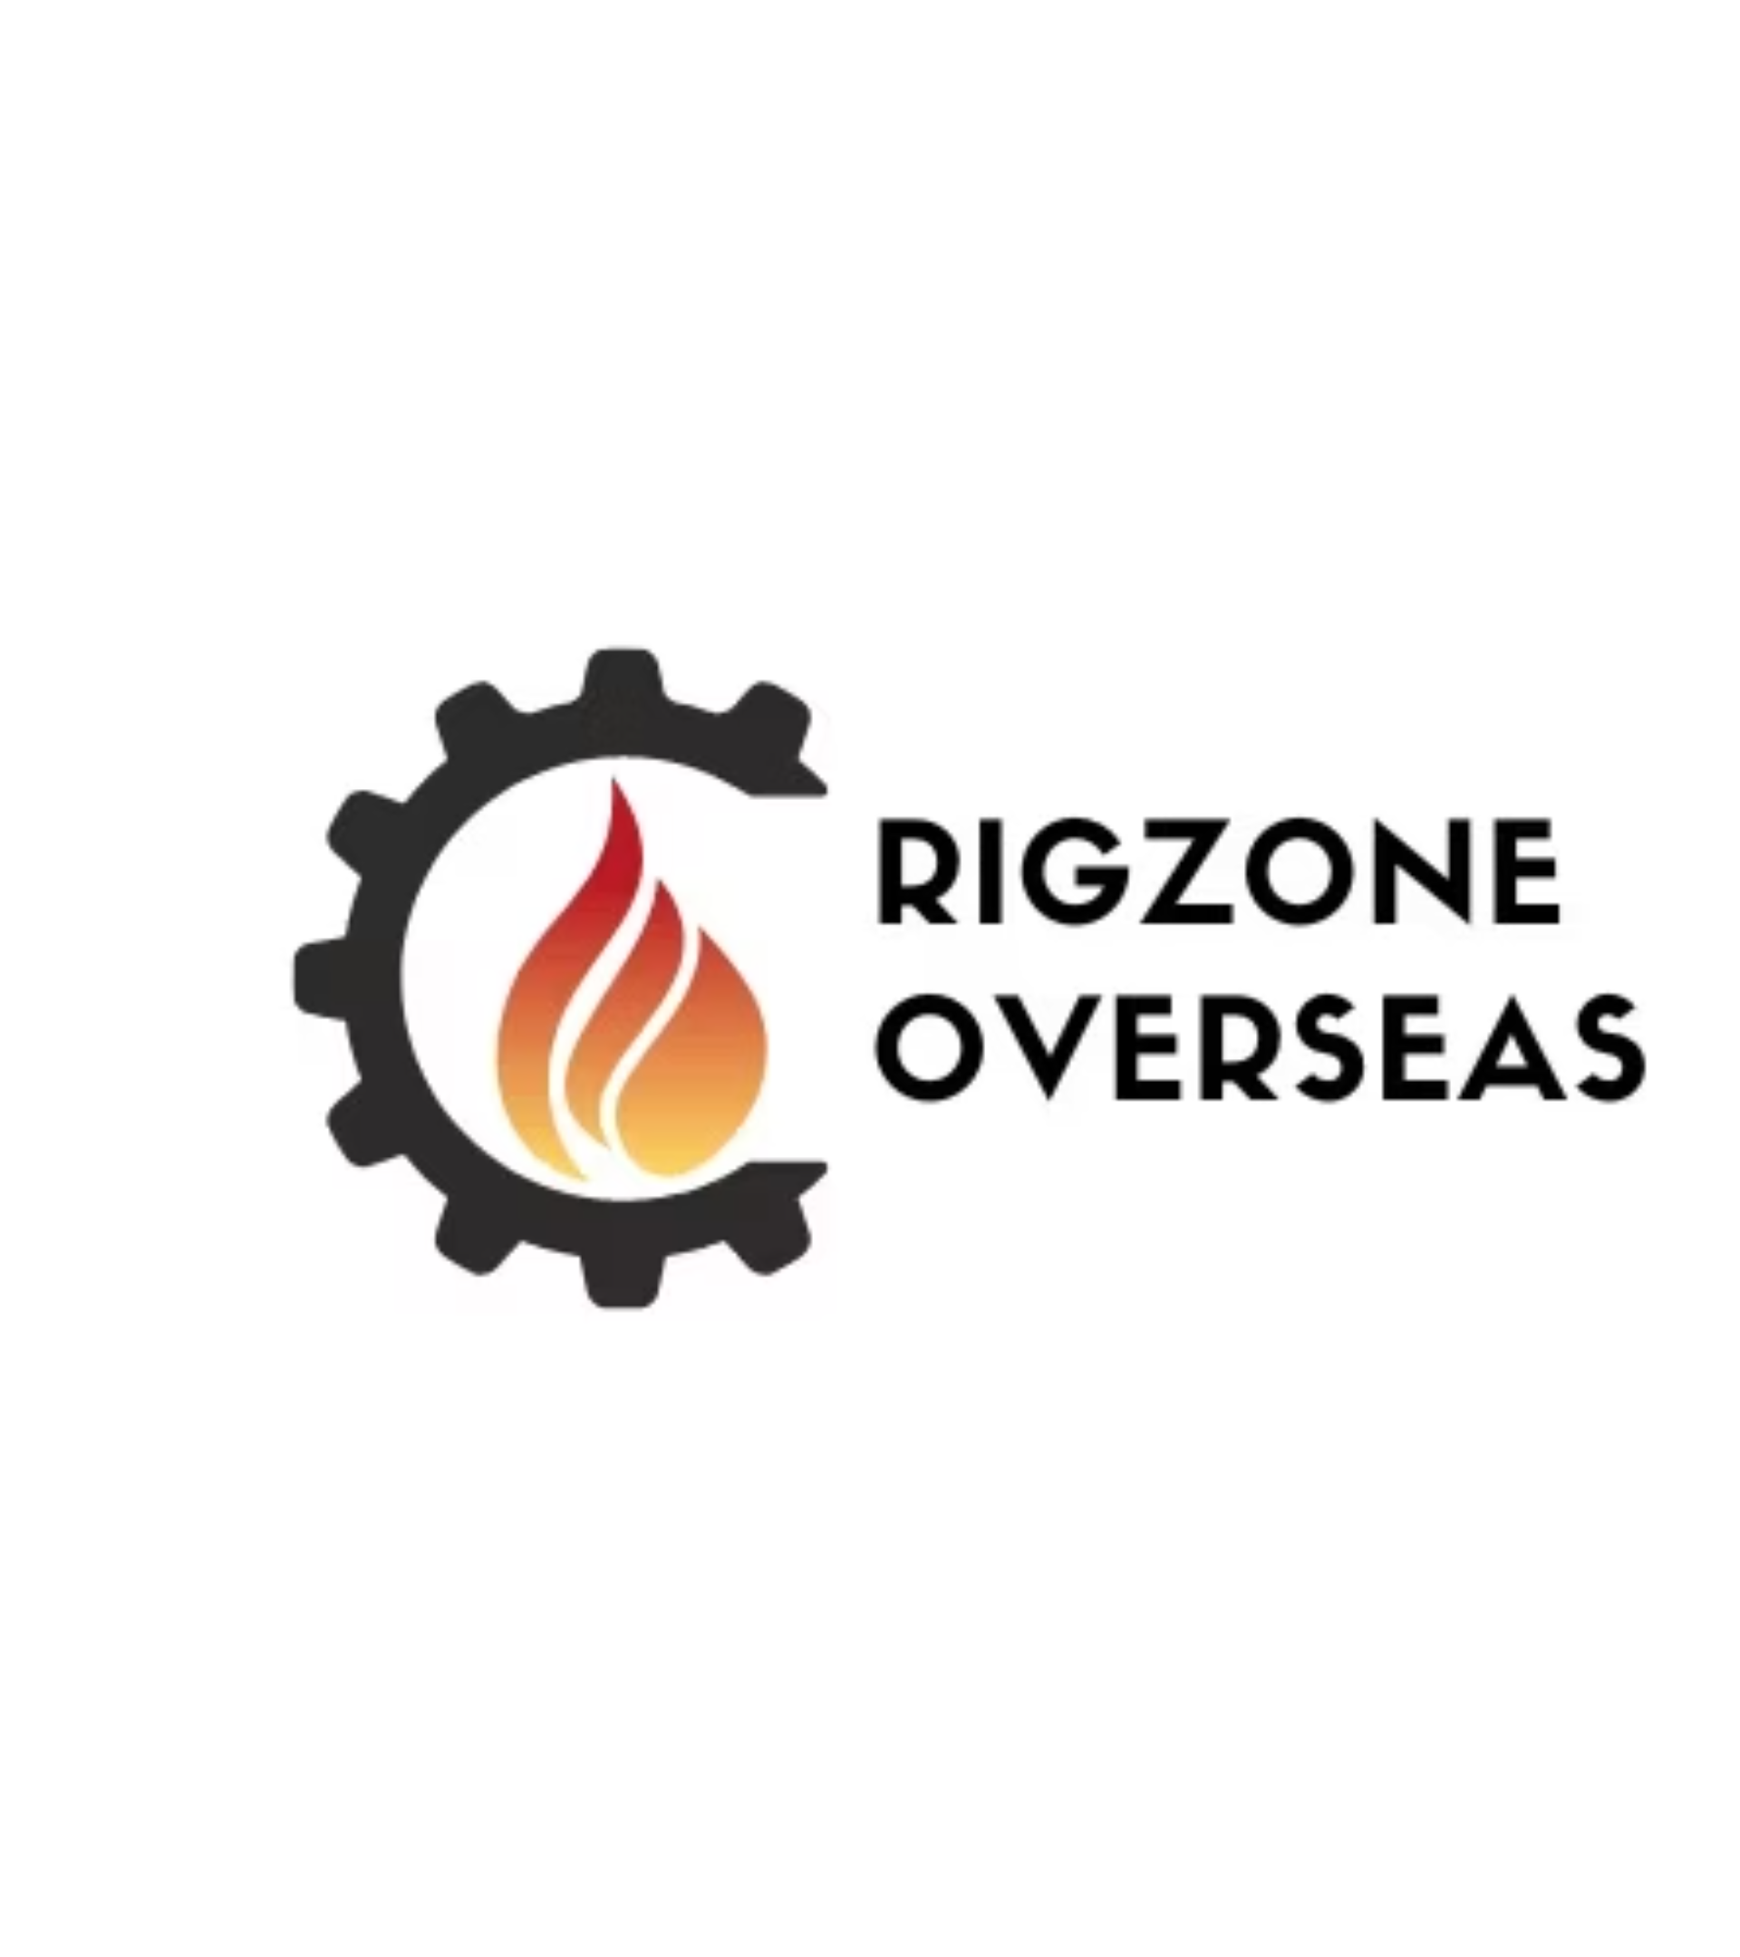
Your Trusted Partner in Rig Inspection Solutions & Training Services

Slide 2
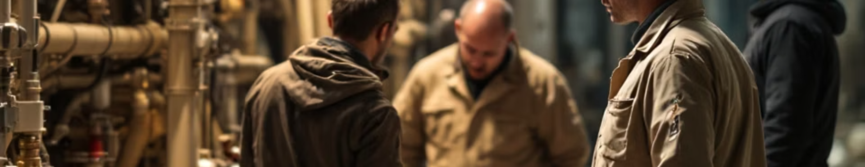
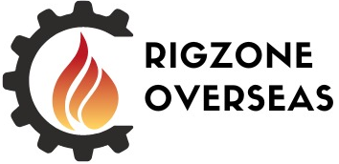
RigZone Overseas: Your Trusted Partner in Rig Inspection Solutions
RigZone Overseas is a leading provider of specialized inspection and technical services for the oil and gas industry. Established in 2018, we have built a strong reputation for technical expertise, reliability, and commitment to safety in the drilling industry. With over 6 years of proven excellence, we deliver comprehensive rig inspection and commissioning services.

Slide 3

About RigZone Overseas
Global Presence
Established in UAE, with recent expansion in Egypt, Iraq, Kuwait, Libya, & Nigeria
Specialized Services
Primarily Rig Inspection Services with certified inspectors
Expert Team
Highly skilled engineers and consultants with extensive industry knowledge

Slide 4
Our Vision and Mission
Vision
Mission
To be the global leader in providing specialized inspection and technical services for the oil and gas industry.
To deliver comprehensive and high-quality services that ensure operational excellence, safety, and reliability in the oil and gas industry.

Slide 5




Core Values
Safety First
Integrity
Health, Safety, Environment, and Quality must come first in everything we do.
Treating ourselves and our business in an honest, ethical, and trustworthy manner.
Efficiency
Providing cost-efficient services to our customers.

Slide 6

Quality at RigZone Overseas
Success Criteria
Document Review
Quality of services and accurate pricing complemented with an effective marketing strategy.
Reviewing all quality-related documents according to standards by qualified engineers.
Staff Training
ISO Compliance
Leading training and improvement of staff to foresee and prevent problems.
Following ISO 9001 and ISO 45001 Requirements for Safety and Environment.

Slide 7




Our Commitment
1
Complete and Integrated Services
2
High Ethical Standards
3
Zero Incident Policy
4
Comprehensive HSE Management
RigZone Overseas is dedicated to providing complete and integrated services for our clients, covering all aspects of requirements, training, services, and support.

Slide 8
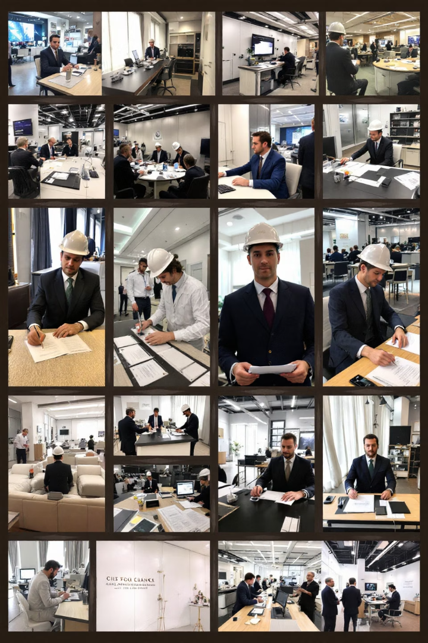
Our Business Services
Rig Surveys and Audits
Specialized Inspections
Full Rig Condition Surveys, Rig Auditing, Rig Acceptance, & Rig Commissioning and Assessments.
Electrical Hazardous Area Inspection, Thermal Imaging Inspection, Lifting Gear Inspection, Rope Access, & Dropped Object Survey.
NDT and Engineering
Additional Services
NDT Inspection Services, Tubular Inspection, Welding Inspection, Hydro Testing, Engineering Inspection.
Training Services, Engineering Consultations, Manpower Supply.

Slide 9
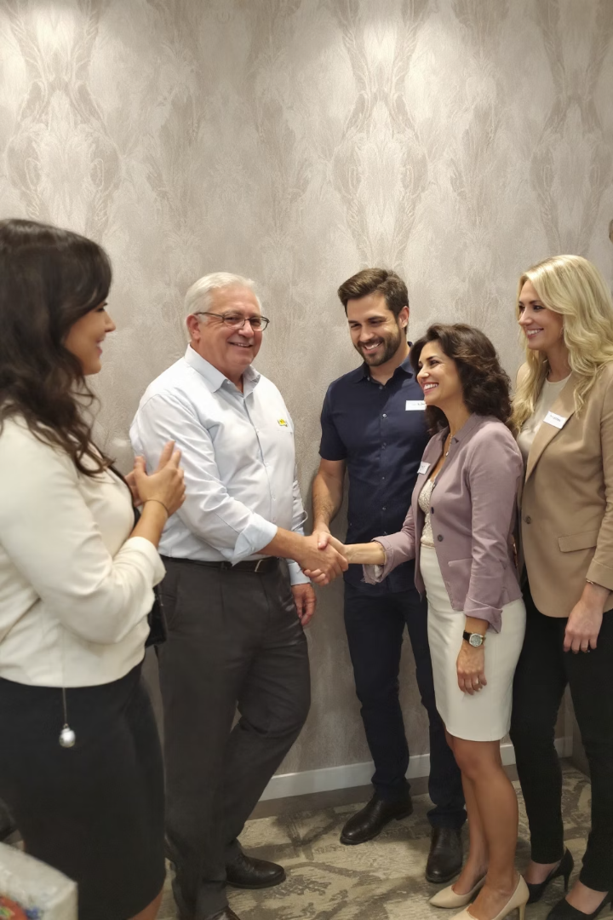
RigZone Overseas Projects Portfolio
5+
200+
Clients
Projects
Trusted by multiple industry leaders
Successful projects completed
90%
Customer Satisfaction
High satisfaction rate among clients

Slide 10
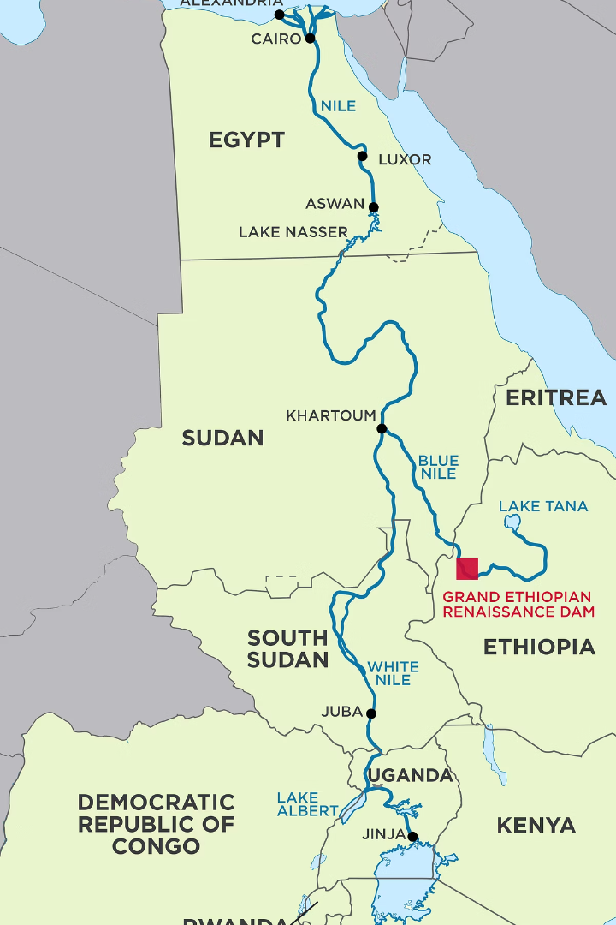
Key Projects (2018-2024)
1
2018: Egypt
Rig Inspection Services consultancy
2
2019: Sudan
Rig Inspection, Rig Auditing, & Rig Acceptance Services for 2B OPPCO
3
2020: Ethiopia
Rig Inspection Workshop (RIW) Training Campaign
4
2021-2024: Western Desert, Egypt
Rig Inspection, Auditing, & Acceptance Contract

Slide 11
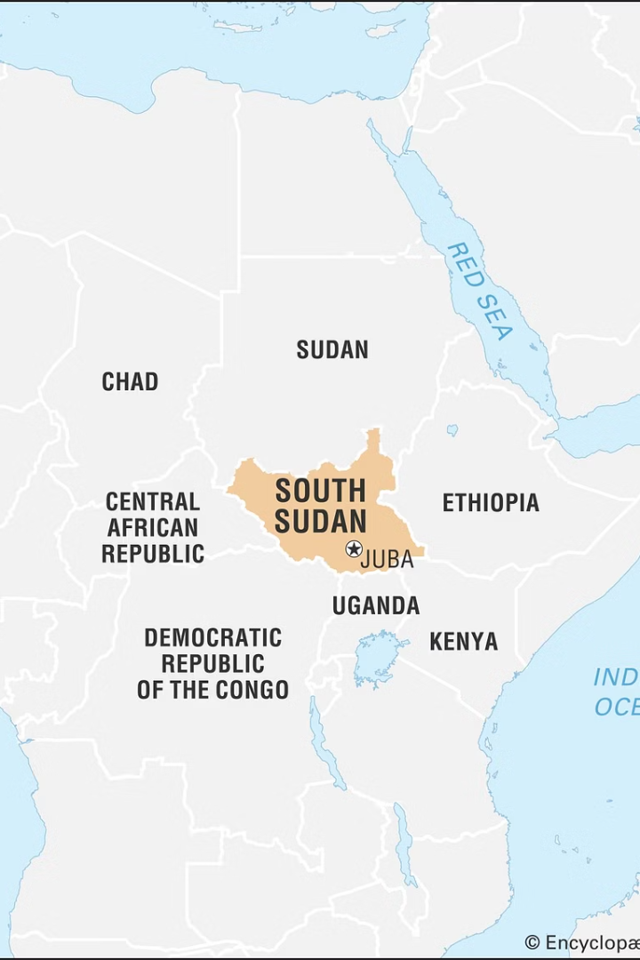
Recent Projects (2022-2024)
1
2022: Juba, South Sudan
Sub-Contractor Rig Inspection, Rig Auditing, & Rig Acceptance Services
2
2022: Western Desert, Egypt
TBG EUE Thread Protectors
3
2023: DASCO for Petroleum Services, Egypt
Ex Survey, Dropped Object Survey, & RIW Training
4
2024: DASCO for Petroleum Services, Egypt
Ex Survey Campaign

Slide 12
RigZone Overseas Regional Expansion
Oman
Iraq & UAE
Libya
Partner: HEAVY EQUIPMENT MAINTENANCE AND TRADING LLC (HEMT)
Partner: NAFTA Technology Development Co.
Partner: Geopetroleum for Oil & Gas, Mining, and Environmental Services (GPPG)
Scope: All RigZone Overseas Offered Services, Training, and AZ well drilling data management
Scope: All RigZone Overseas Offered Services
Scope: All RigZone Overseas Offered Services

Slide 13

RigZone Overseas Achievements Over 6 Years
200+ Projects
80% Client Retention
Completed across various service types, including rig inspections, maintenance, and emergency repairs.
Demonstrating trust in our expertise and services.
25% Downtime Reduction
Zero Incidents
Reported during inspections and repairs, improving safety standards.
Average reduction in operational downtime across multiple clients.

Slide 14

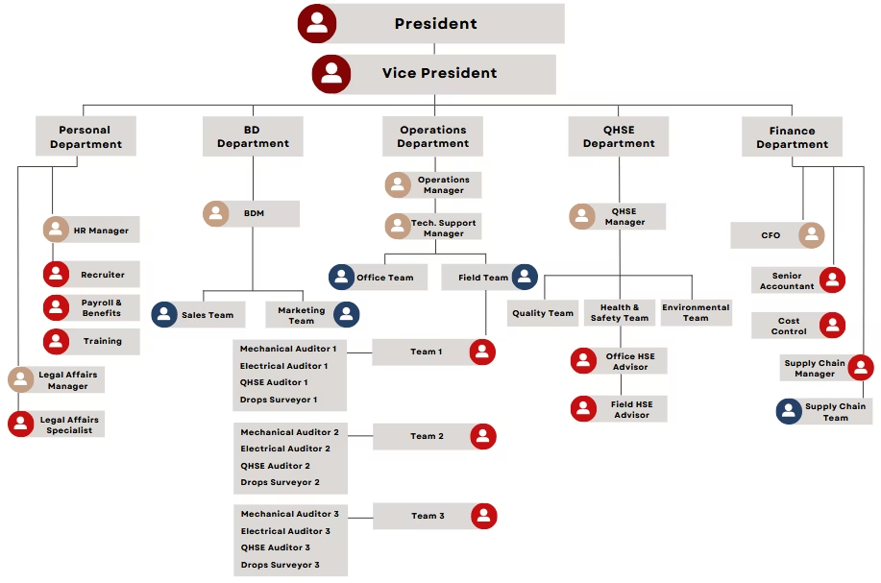
RigZone Overseas Structure
Our organizational structure ensures efficient operations and clear lines of responsibility across all our service areas.

Slide 15
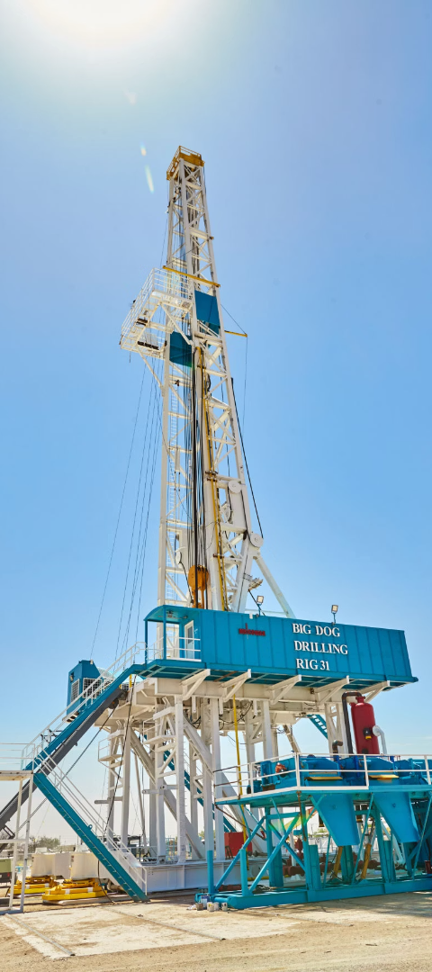




Types of Rigs and Applicability
Onshore Rigs
Offshore Rigs
Focus on structural stability, power systems, and mobility components.
Emphasis on corrosion protection, stability in marine environments, and compliance with maritime regulations.
Jack-Up Rigs
Drill ships and Semi-Submersibles
Inspections of legs, jacking systems, and hull integrity.
Evaluations of dynamic positioning systems, ballast tanks, and subsea equipment.

Slide 16



Categorization of Findings
Critical Issues
1
Immediate risks to safety, integrity, or compliance
Major Issues
2
Significant operational or safety risks if unaddressed
Minor Issues
3
Cosmetic or low-risk issues

Slide 17





Reporting Systems
Daily Reports
Immediate findings and progress updates
Action Tracker
Excel sheet for tracking issue resolution
HSE Report
Safety observations and recommendations
Final Report
Comprehensive overview of inspection results

Slide 18
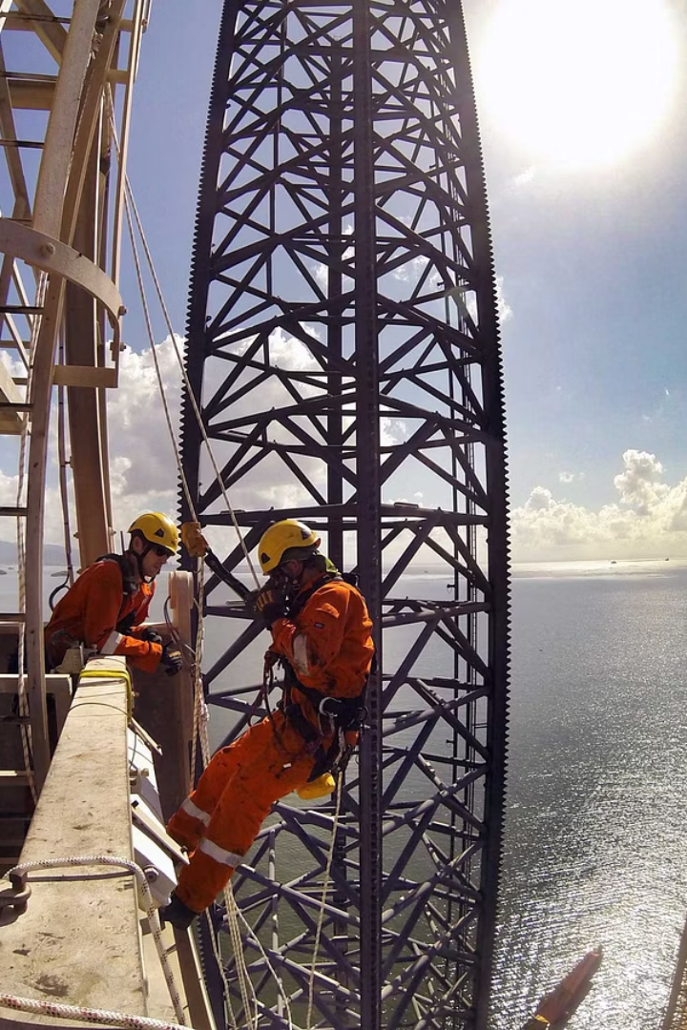
Advanced Rig Inspection
A comprehensive, high-level inspection focusing on detailed assessments and advanced methodologies to evaluate the condition and performance of rig structures, systems, and components.
1
Rig Acceptance
Initial survey to establish a baseline for the rig's condition.
2
Full Condition Survey
Detailed inspection within the first six months to identify and address deeper issues.
3
Rig Audit
Periodic audits every 6 months to ensure sustained performance and compliance.

Slide 19
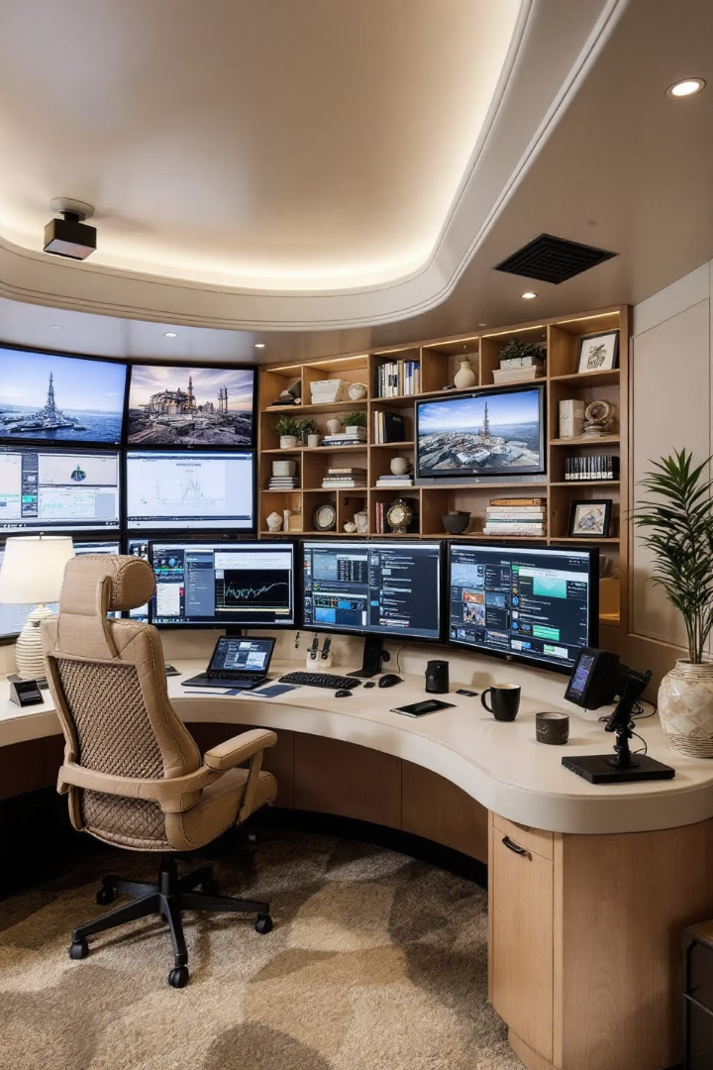
Remote Rig Audit
Digital Tools
Efficiency
Utilizing advanced sensors and communication technologies for remote monitoring.
Minimizing downtime and reducing costs through remote inspections.
Comprehensive Coverage
Monitoring safety, operational status, and regulatory compliance remotely.

Slide 20
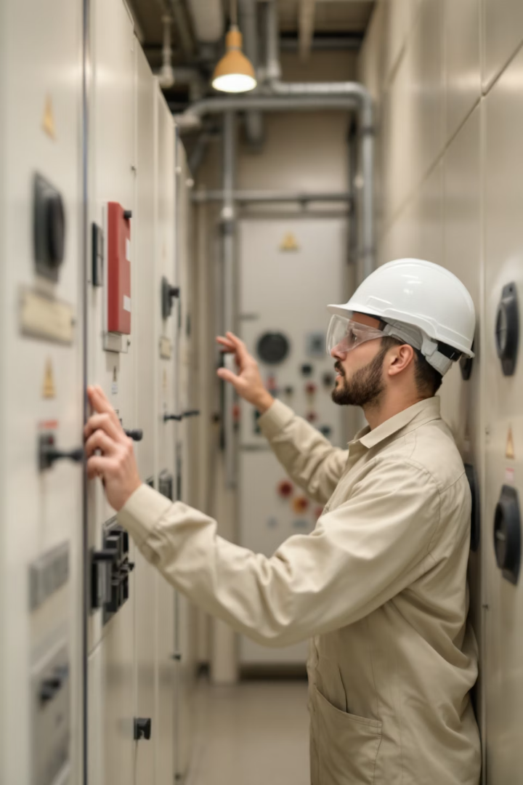
Electrical Hazardous Area Inspections
Evaluating electrical installations in environments where there is a risk of explosion, such as offshore rigs or oil and gas facilities. Our certified inspectors conduct detailed assessments to ensure compliance with local and international safety standards (such as ATEX or IECEx).
Risk Identification
Identifying potential risks related to electrical systems in hazardous areas.
Compliance Assurance
Ensuring adherence to ATEX, IECEx, and other relevant standards.
Accident Prevention
Implementing measures to prevent electrical-related accidents in hazardous areas.

Slide 21
Thermal Imaging Inspection
Thermal Imaging Inspection uses infrared cameras to detect heat anomalies in equipment and systems, which can indicate potential issues such as electrical faults, leaks, or mechanical wear.
Non-Invasive Method
Preventative Maintenance
Wide Application
Inspect equipment without disrupting operations.
Identify problems before they lead to failures.
Suitable for motors, transformers, piping, and more.

Slide 22
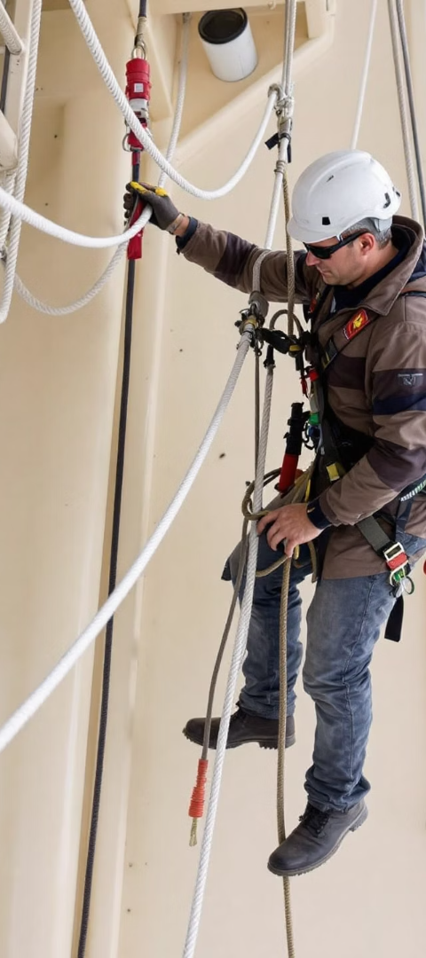



Lifting Gear Inspection, Rope Access, & Dropped Object Survey
Lifting Gear Inspection
Rope Access
Ensures all lifting equipment is properly maintained, certified, and safe for operation.
Uses ropes and climbing equipment to access difficult-to-reach areas for inspections and maintenance.
Dropped Object Survey
Identifies and mitigates the risk of objects falling from heights, protecting workers and equipment.

Slide 23
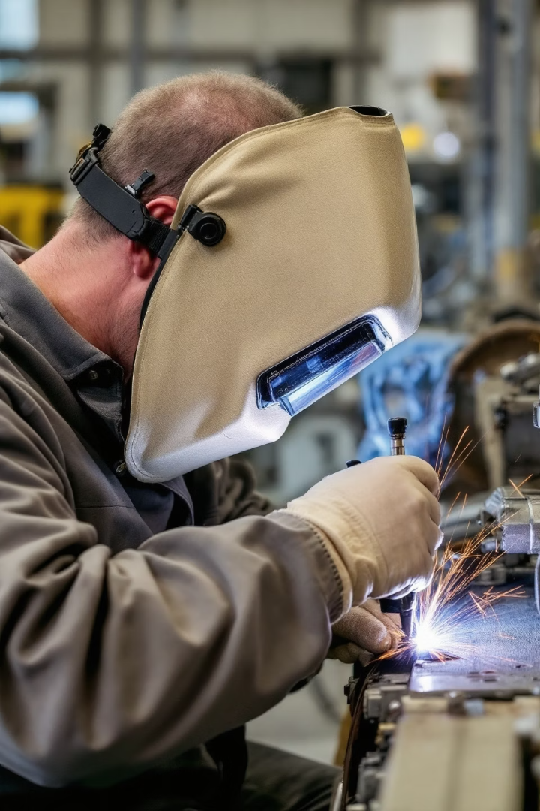
Welding Inspection Services
Visual Inspection Testing (VT)
Dye Penetrant Inspection (DPI)
Cost-effective method for assessing surface defects and weld profiles.
Non-destructive testing to detect surface-breaking defects in non-porous materials.
Magnetic Particle Inspection (MPI)
Ultrasonic Inspection (UT)
Widely used NDT method for detecting surface and near-surface defects in ferromagnetic materials.
Highly accurate NDT method using high-frequency sound waves to detect internal defects.

Slide 24
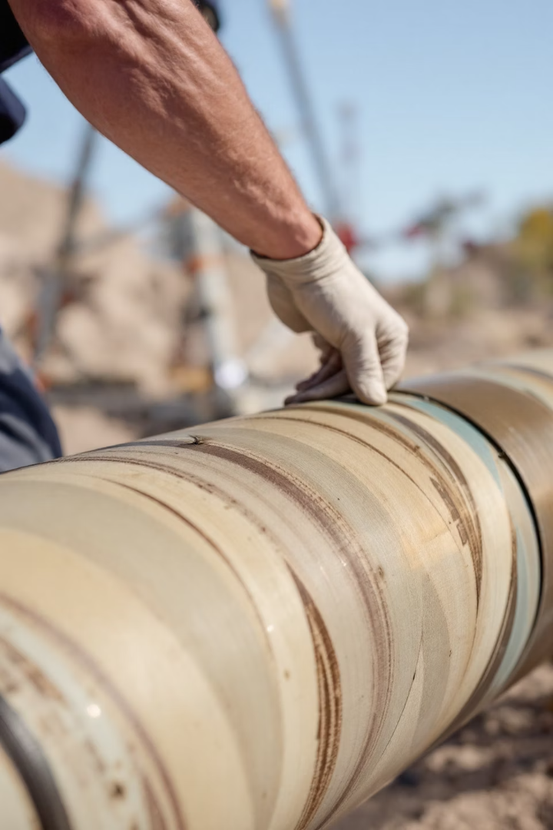
Tubular Inspection Services
Tubular goods, including drill pipes, casings, and tubing, require regular inspections to ensure structural integrity and safe operations.
Full-length Inspection
Examination of tubular goods for cracks, corrosion, and wear.
Thread Inspection
Detailed assessment of threaded connections.
Hardness Testing
Evaluating material properties for safety and performance.

Slide 25
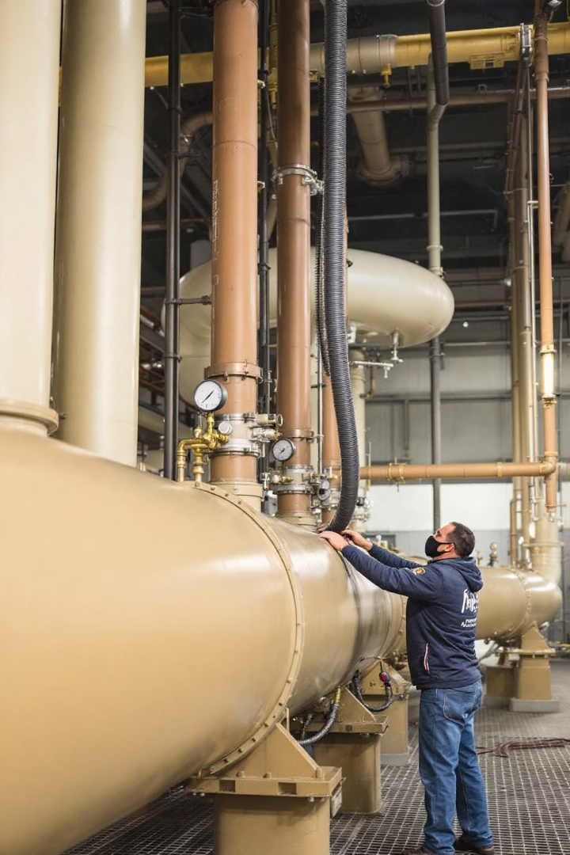




Hydro Testing
Hydro Testing involves filling a pipeline, pressure vessel, or other container with water and pressurizing it to ensure it can safely withstand expected operational pressures.
Filling
Container filled with water
Pressurizing
Increase pressure to test levels
Monitoring
Observe for leaks or weaknesses
Evaluation
Assess structural integrity

Slide 26
Training and Consultancy Services
Rig Inspection Training
Consultancy Services
Combined Programs
Comprehensive programs covering API standards, NDT methods, and rig components.
Operational assessments, compliance audits, and incident investigations.
Integrating training and consultancy for holistic rig management and personnel development.

Slide 27




Manpower Supply
RigZone Overseas supplies highly trained Drilling engineers, Rig Crew, and specialists for a range of tasks including inspections, maintenance, operations support, and project management.
Drilling Engineers
Rig Crew
Experienced professionals for complex drilling operations.
Skilled personnel for efficient rig operations.
Specialists
Experts in specific areas like NDT, maintenance, and project management.

Slide 28

Why Standards Matter
API standards are the backbone of our operations, ensuring that every service we deliver meets stringent global benchmarks.
API RP 4G
Guidelines for inspection and maintenance of drilling structures.
API RP 7G
Procedures for drill stem elements.
API STD 53
Standards for blowout prevention equipment systems.
DROPS Guidelines
International best practices for mitigating dropped object hazards.

Slide 29





Our Strengths
Professional Expertise
Adherence to Standards
Highly trained team with extensive experience in rig inspection and maintenance.
Strict compliance with API standards and client-specific requirements.
Client-Centric Approach
Innovative Solutions
Tailored solutions to meet unique client needs.
Utilizing latest tools and technologies for precise and reliable results.

Slide 30

Benefits of Partnering with RigZone Overseas
Uncompromised Safety
Enhanced Performance
Adherence to API standards ensures highest safety levels, reducing risk to personnel and assets.
Regular inspections and maintenance optimize rig functionality, minimizing downtime.
Cost Efficiency
Regulatory Compliance
Proactive identification of potential issues saves clients from costly repairs and operational disruptions.
Detailed audits and inspections ensure rigs meet international and local standards.

Slide 31



Contact RigZone Overseas Today
Ready to elevate your rig operations to the next level? Contact RigZone Overseas today and let us partner with you for success. Together, we'll ensure your rigs operate safely, efficiently, and in compliance with all standards.
Phone
Email
Address
01223424778
Info@rigzone-eg.com
Block 6101, 5th District, Middle Plateau, Mokattam, Cairo, Egypt

